Slide 1
ESV Presentation

Slide 2
Safety Problem

Slide 3
Current Methods

Slide 4
Proposed Method
Autonomously maneuver a car to safety before an accident can occur
Rapidly-Exploring Random Tree (RRT) algorithm to generate safe paths in a changing environment

Slide 5
Evaluation
Single obstacle (moving across the road, or stationary)
Straight road
No other traffic
Currently tested in a virtual environment

Slide 6
Metrics
The vehicle must stay on the road
The vehicle must not collide with the obstacle
The vehicle must execute dynamically safe maneuvers

Slide 7
Results
Can determine if a safe path is possible within a few milliseconds
Can quickly re-generate paths to take into account environmental changes
Can avoid moving obstacles by predicting where they will be

Slide 8
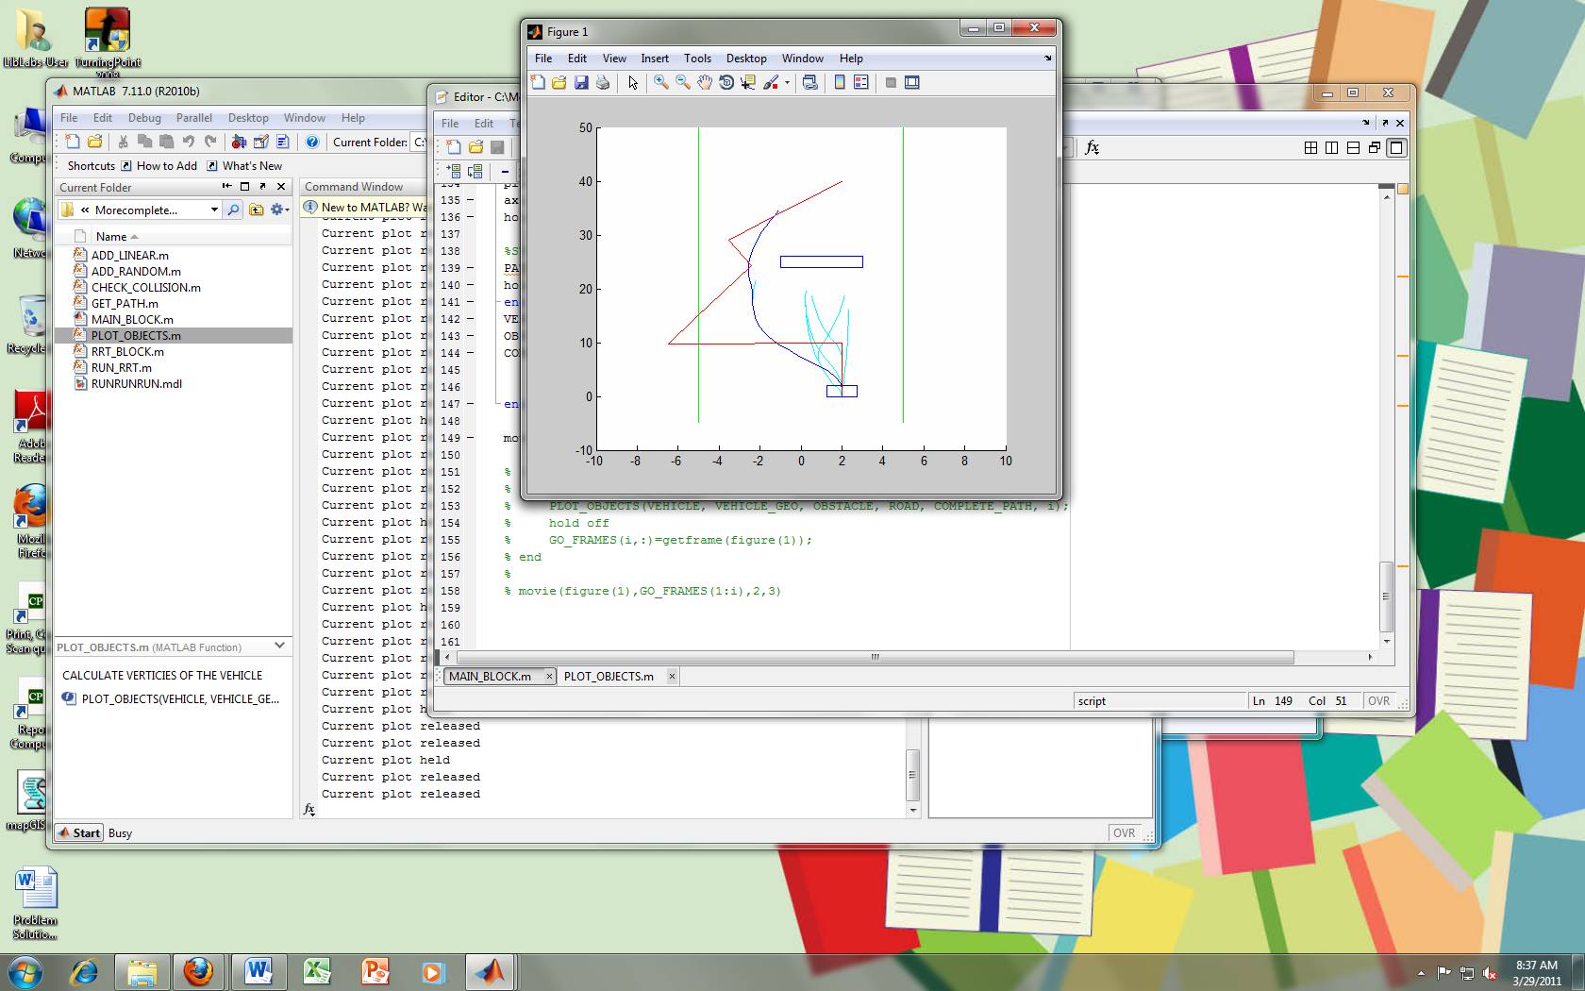
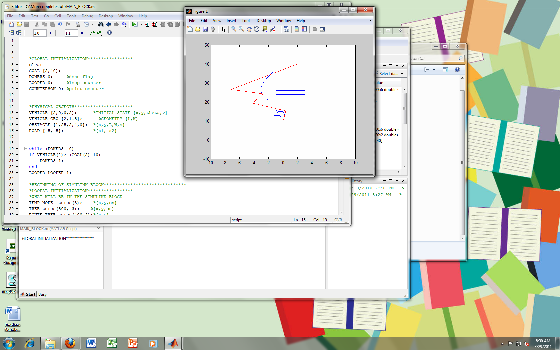
Results
Initial path calculation
Re-calculation during maneuvering

Slide 9
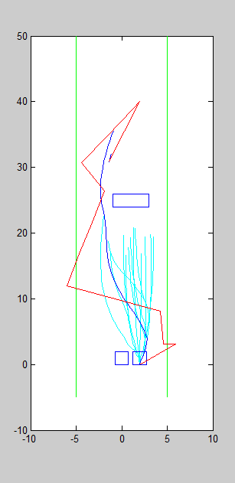
Results
Matlab movie

Slide 10
Physical Testing
Run on an R/C truck
Truck will be manually controlled until a potential collision is detected
At this point a computer will take over and steer the truck to safety

Slide 11
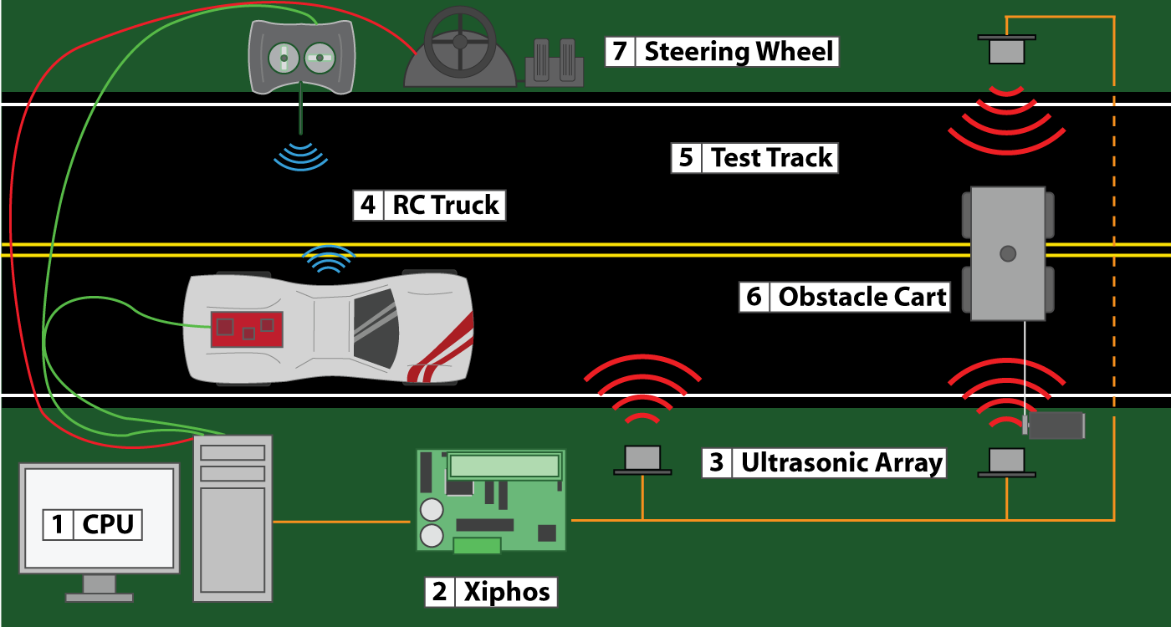
Physical Testing

Slide 12
Effects on Safety

Slide 13
Application

Slide 14
Matlab Model

Slide 15
Vehicle performance

